Slide 1


Date: Monday, 2nd February 2026
Title: Legislation and Business
Read each of the following statements. Write “True” if you think it’s a real legal requirement for businesses, or “False” if you think it’s not.
A business must refund a customer if the product is faulty.
A business can legally pay 15-year-olds £1.50 per hour.
A business can fire an employee for being pregnant.
All employees must be given safety training.
Shops don’t have to accept returns for any item once it’s been opened.
True
False

Slide 2
Date: Monday, 2nd February 2026
Title: Legislation and Business
1 = ✅ True (Consumer Rights Act)
2 = ❌ False (Below minimum wage)
3 = ❌ False (Illegal – Equality Act)
4 = ✅ True (Health & Safety at Work Act)
5 = ❌ False – depends on the item and if it’s faulty

Slide 3
THE PURPOSE OF LEGISLATION
The term legislation refers to the laws of a country.
LAW: A rule made by a government that states how people may and may not behave in society and in business, and that often orders particular punishments if they do not obey, or a system of such rules.
In the business world, legislation is used to regulate the actions of businesses and prevent them from exploiting people.
No matter how big or small a business is, it must abide by the legislation of the country that it operates within.

Slide 4
THE PURPOSE OF LEGISLATION
In the UK, there are two key areas of legislation set by the government which are designed to protect the rights of consumers and the rights of employees and employers.
These two key areas of legislation are known as:
Principles of consumer law
Principles of employment law

Slide 5
PRINCIPLES OF CONSUMER LAW
Consumer law relates to any piece of government legislation which relates to the quality of products or services and the rights of consumers.
In the UK there are two consumer laws which businesses must adhere to, these are:
Consumer Rights Act (2015)
Consumer Protection Act (1987)

Slide 6

Legislation in Business- Why Rules Matter
Today, you'll become business law detectives! Let's find out how laws protect consumers and workers. Sue the business or let it go? Justify your answer
1.You buy a new phone that stops working after 3 days.
It won’t turn on, and the store refuses to replace it.
2. You buy a “scratch-proof” phone case. It gets scratched the first day.
3. You’re injured by a broken chair at a café. The manager says it’s “not their fault.”
4. You buy a second-hand game console that turns out to be faulty.
The shop says “No refunds for second-hand goods.”
5. A cleaning product claims it removes red wine stains but actually makes them worse.

Slide 7
PRINCIPLES OF CONSUMER LAW: CONSUMER RIGHTS ACT (2015)
The Consumer Rights Act (2015) is designed to protect consumers from unfair and dishonest business practices by providing them with “transparent rights that will help them to make better choices when they buy, generating the opportunity for businesses to compete, innovate and grow…so businesses and consumers create an economy based on productive relationships and fairly won business reputations” (GOV, 2022).
To ensure this is achieved, the Consumer Rights Act (2015) covers the key areas of a business transaction, which include:
The product or service
Returns
Repairs and replacement
Delivery
Put this on a mind map
Notes:
https://www.gov.uk/government/publications/consumer-rights-act-2015/consumer-rights-act-2015

Slide 8

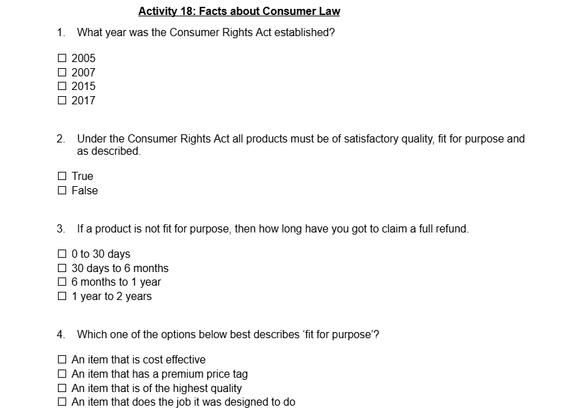
Activity: Facts about Consumer Law
Watch the video about consumer law and answer the multiple choice questions in your book:
Notes:
https://www.youtube.com/watch?v=eaqQX5BU5L4&t=10s

Slide 9
KEY SUMMARY OF THE CONSUMER RIGHTS ACT 2015

Slide 10
Principles of Consumer Law
As contained in the Consumer Rights Act of 2015:
Goods must be:
Described accurately – businesses should not describe goods and services in a misleading way.
Fit for purpose – goods must do what they are designed to do.
Satisfactory quality – goods should not be damaged or faulty when sold as new.

Slide 11
Services should be;
Supplied under minimum standards, which include:
The service provider must use reasonable care and skill in delivering the service
Any written or verbal information provided by the supplier is binding
The service must be provided in a reasonable time, unless agreed otherwise
The service must be provided for a reasonable price, if the price is not agreed beforehand

Slide 12
Digital Content
The requirements for goods also apply to digital content.
Corrupted Digital Content
Consumers are entitled to a repair or replacement if the digital content is faulty and even compensation if other downloads or devices are affected.

Slide 13

PRINCIPLES OF CONSUMER LAW: CONSUMER PROTECTION ACT (1987)

Slide 14

PRINCIPLES OF CONSUMER LAW: CONSUMER PROTECTION ACT (1987)
The Consumer Protection Act (1987) gives consumers the ”right to claim compensation against the producer of a defective product if it has caused damage, death or personal injury” (Which, 2022).
Notes:
https://www.which.co.uk/consumer-rights/regulation/consumer-protection-act-1987-a5xTL3w6L9OI

Slide 15
PRINCIPLES OF CONSUMER LAW: CONSUMER PROTECTION ACT (1987)
If a product does become defective, the producer of the defective product is automatically liable for any damage caused to consumers under the Consumer Protection Act (1987).
Meaning the act helps to raise standards and due care in the production process to ensure products are of the highest quality and the risk of any defects and damage to consumers is reduced.
Notes:
https://www.which.co.uk/consumer-rights/regulation/consumer-protection-act-1987-a5xTL3w6L9OI

Slide 16
Activity: Consumer Law Scenarios
Read the four scenarios below and state what the consumer’s rights are and how the business should deal with each issue in your book.
You buy an iPhone but find after 2 days, that it won’t turn on and it won’t charge up. The iPhone is not of satisfactory quality.
You buy a product that tells you it can remove stains from car upholstery. You try it when you get it home but all it does is make the stain larger. The product does not work as it should and is not fit for purpose.
You bought a second-hand product and when you open the box it is broken and not by any fault of your own, but just because the item was faulty. You take the item to the store, but they say it cannot be returned or refunded because it is a second hand good.
You find a shirt that fits you perfectly. You purchase it and wear it to a business meeting. In under 28 days you decide that you don’t like the look of the shirt anymore so decide to take it back for a refund, you have only worn it once.

Slide 17

Activity
You’ve been hired by Trading Standards UK to design an eye-catching poster that teaches people their consumer rights.
You must also prepare a 60-second pitch to explain your poster to the class.
Poster Must Include:
A title (e.g., “Don’t Get Ripped Off!” or “Your Rights, Your Power”)
At least 3 key rights from consumer law (e.g. fit for purpose, satisfactory quality, safety)
Visual examples (e.g. a faulty product, misleading advert, unsafe charger)
A clear message about what customers should do if things go wrong
Bright, bold, clear layout – make it classroom display-worthy!

Slide 18
Task
Which of the following is not one of the principles of the Consumer Rights Act (2015)?
The product must be of satisfactory quality
The product should be unfit for purpose
The product must be as described
Which of the following statements about legislation is true?
All staff must be paid the same wage under national minimum wage legislation
Businesses must not describe the features of a product in advertisements
It is an offence for a business to break health and safety laws
Which of these is a service?
A takeaway pizza
pair of trainers
A haircut

Slide 19
CONSUMER RIGHTS ACT (2015)- KEY AREAS
The Consumer Rights Act (2015) is designed to protect consumers from unfair and dishonest business practices.
To ensure this is achieved, the Consumer Rights Act (2015) covers the key areas of a business transaction, which include:
The product or service
Returns
Repairs and replacement
Delivery
Notes:
https://www.gov.uk/government/publications/consumer-rights-act-2015/consumer-rights-act-2015

Slide 20

Some key points of the consumer rights act 2015 include:
Categorise these into the key areas
Goods must be of satisfactory quality, fit for purpose for what they are used for and how they are described to the customer
Customers have the legal right to reject goods within 30 days if there’s something wrong with the item
After 30 days customers have the right to a repair, replacement or refund for faulty goods
Digital content such as films or games online, should also be of a suitable quality
The retailer is responsible for the safe delivery of goods
A business not providing a service must provide the service with reasonable care and should be redone or corrected if they do not
Businesses are not allowed to enforce unfair terms when selling goods or services and this may even lead to court cancelling a contract that is judged as unfair.

Slide 21
Activity
Sofia orders a “100% wool winter coat” from an online retailer. When it arrives, the label shows it is mostly polyester, and it feels much thinner than expected. The website photos also made the coat look longer. The company offers her store credit only.
Advise Sofia on her consumer rights. 3marks
Amir buys a new kettle from a high-street shop. When he uses it at home for the first time, it switches off by itself and smells of burning plastic. He takes it back to the shop two days later, but the shop assistant says, “You’ve opened the box, so we can’t refund you.”
Advise Amir using the Consumer Rights Act. 3marks
Liam pays a local garage to service his car before a long journey. The garage says the brakes have been checked. Two days later, the brakes make loud noises and feel unsafe. Another mechanic says the brakes were not properly inspected.
Advise Liam using the Consumer Rights Act. 3marks

Slide 22
Legislation in Business- Why Rules Matter
Today, you'll become business law detectives, again! Let's find out how laws protect workers. What would you do?
A job advert says “Only men should apply for this construction role.”
You are hired at a shop but never given a written contract or payslip.
You are told not to apply for a job because of your religion.
Your manager refuses to pay you the minimum wage because you’re “just a student.”
Your employer says you’re not allowed sick leave unless you “work extra hours later to make up for it.”

Slide 23
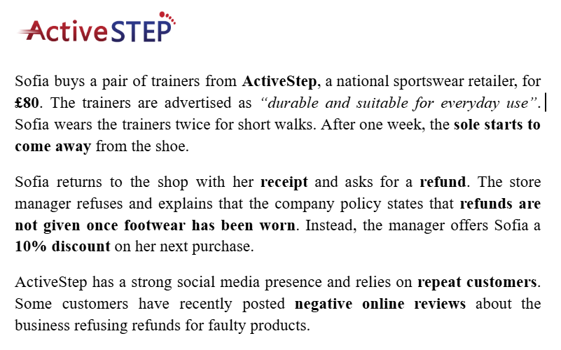
Exam Style CASE STUDY
Exam questions:
a) Identify one consumer right that applies to Sofia’s situation. (2 marks)
b) Explain why ActiveStep’s response may be breaking consumer rights law. (3 marks)
c) Analyse the possible impact on ActiveStep if it continues to refuse refunds for faulty products. (6 marks)

Slide 24

Sample Answers for question 3
If ActiveStep continues to refuse refunds for faulty products, this could have a negative impact on its reputation and sales. Customers like Sofia may feel treated unfairly, especially as the trainers were faulty after only two uses. This could lead to more negative online reviews, which is particularly damaging because ActiveStep relies on repeat customers.
ActiveStep refusing refunds is bad because customers will not be happy. The business could lose customers and make less money. This is unfair to Sofia and breaks the law. The shop should give refunds so people are satisfied.
Criticise both answers list atleast 5 things that went well/wrong for each of them

Slide 25
Sample Answers for question 3
Answer 1
✔ Uses the case study
✔ Chains cause → effect → impact
✔ Focuses on the business, not the consumer
✔ Analytical language (“as a result”, “this could lead to”)
Answer 2
✘ Very generic
✘ Limited reference to the case study
✘ No clear cause-and-effect
✘ Mostly descriptive and opinion-based

Slide 26
Activity
You’ve been hired by Trading Standards UK to design an eye-catching poster that teaches people their consumer rights.
You must also prepare a 60-second pitch to explain your poster to the class.
Poster Must Include:
A title (e.g., “Don’t Get Ripped Off!” or “Your Rights, Your Power”)
At least 3 key rights from consumer law (e.g. fit for purpose, satisfactory quality, safety)
Visual examples (e.g. a faulty product, misleading advert, unsafe charger)
A clear message about what customers should do if things go wrong
Bright, bold, clear layout. Make it classroom display-worthy!

